Slide 2
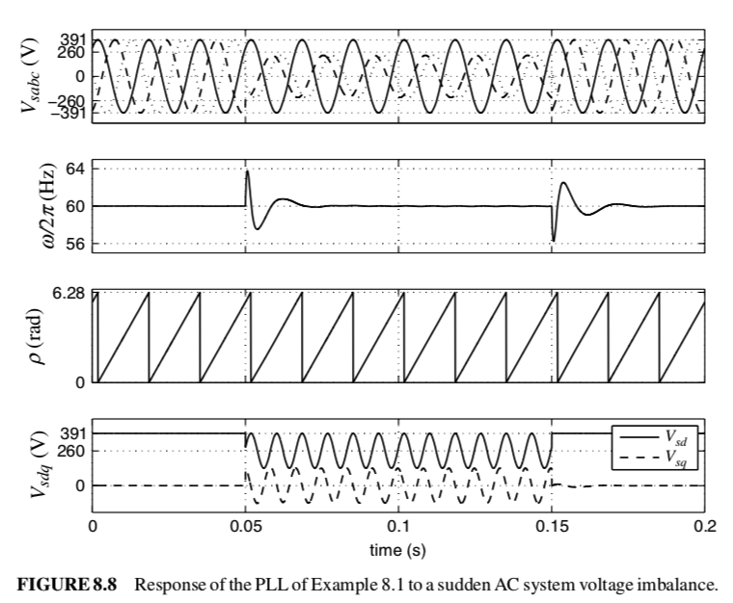

Slide 3
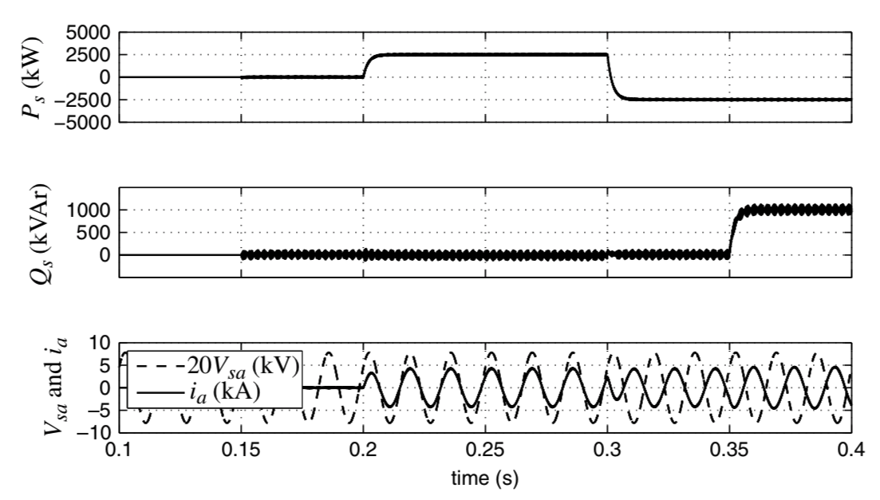
Gating pulses begin at t = 0.15s.
Q: What happened to Q? Why is it a thick line?
A: Ripple due to pwm switching dynamics

Slide 4
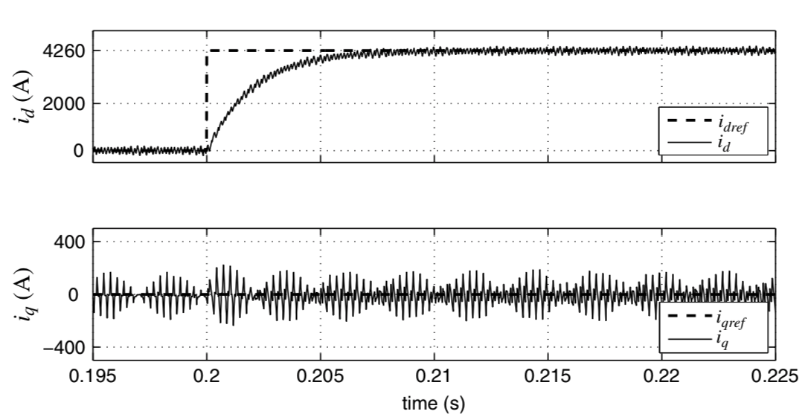

Slide 5
At t = 0.20s, Pref → 2500 kW. What will happen to variables?

Slide 6
At t = 0.30s, command Pref → -2500kW
Q: what will happen to variables?

Slide 7
At t = 0.35s,
Pref = 2500kW
Qref →1000kVA.
What will happen to variables?

Slide 9
Course evaluations
course-evaluations.berkeley.edu

